Slide 1
Pericyclic Reactions
Continuous concerted reorganisation of electrons
5 major categories:
  Electrocyclic ring opening/closure
  Cycloaddition/cycloreversion reactions
  Cheletropic reactions (e.g. carbene addition)
  Group transfer reactions (e.g. H₂ transfer)
  Sigmatropic rearrangements

Slide 2
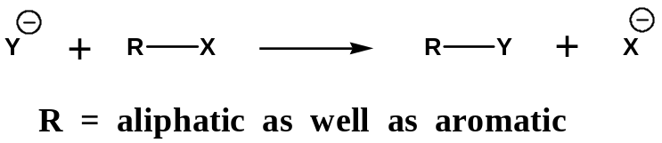
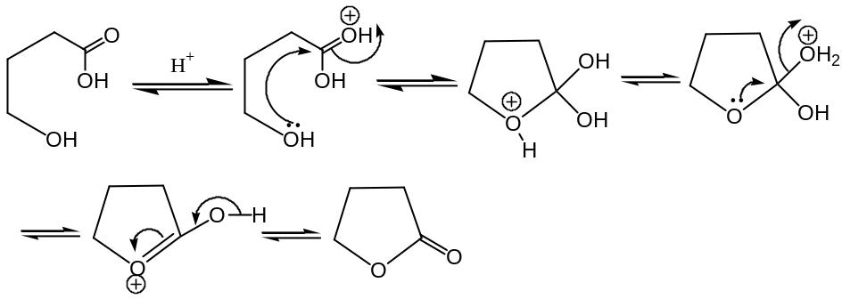
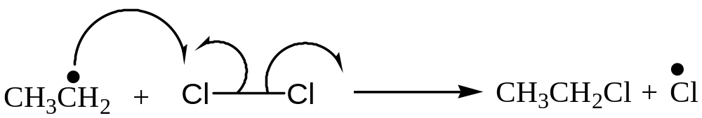
Three Classes of Organic Reactions
Polar reactions
Radical reactions
Pericyclic reactions
This reaction occurs as a result of a cyclic reorganization of electrons

Slide 3
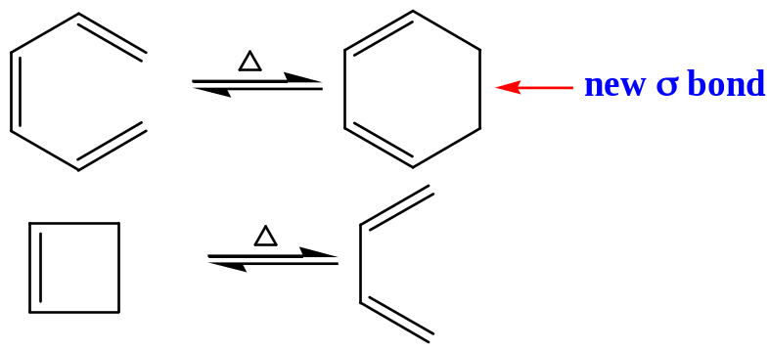
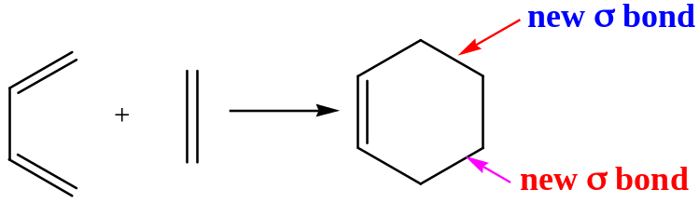
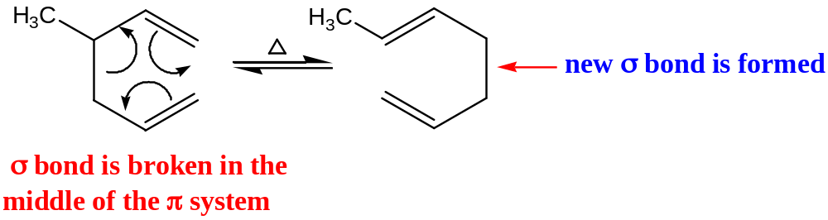
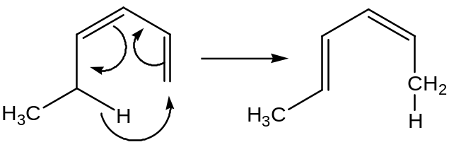
Three most common types of pericyclic reactions
Elcetrocyclic reactions
Cycloaddition reactions
Sigmatropic reactions

Slide 4
Certain common features of pericyclic reactions
They are all concerted reactions
Therefore, there is one TS and no intermediates
As the reactions are concerted, they are highly
stereoselective
The reactions are generally not effected by catalysts
or by a change in solvent

Slide 5
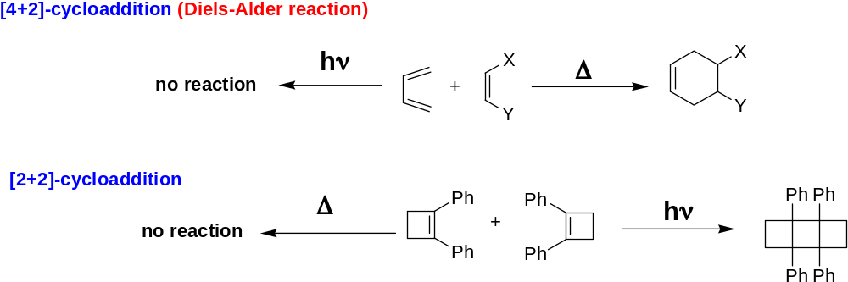
Usually pericyclic reactions are induced thermally and/or photochemically

Slide 6
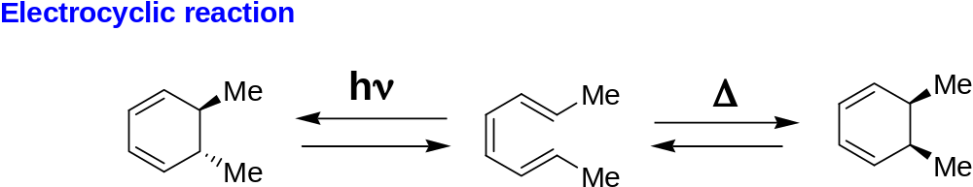
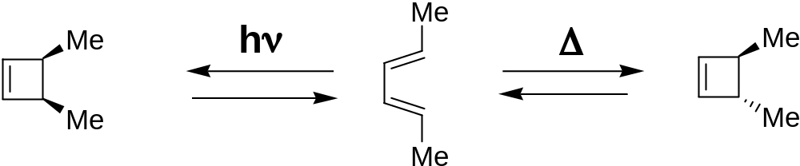

Slide 7
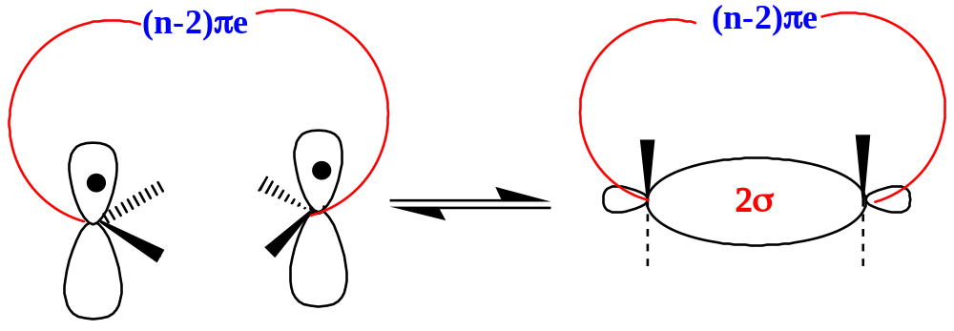
Electrocyclic Reactions
These reactions are defined as involving the cyclization of an n pi-electron
system to an (n-2)pi + 2sigma-electron system or the reverse process.
The reactions are reversible.
Observance of ring opening and ring closure depends
upon the thermodynamic stability of the open and closed forms.

Slide 8
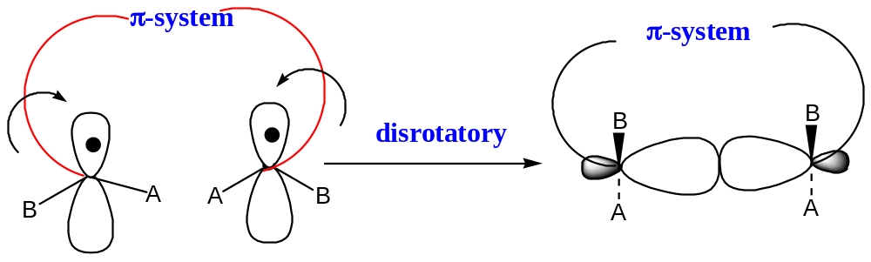
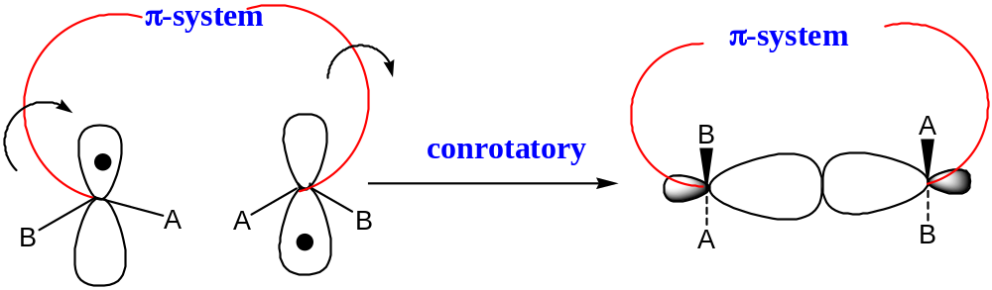
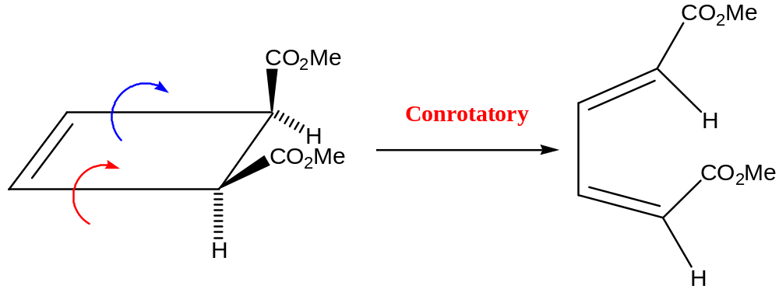
Two distinct modes are possible….
disrotatory
ring closure
conrotatory
ring closure
example:

Slide 9
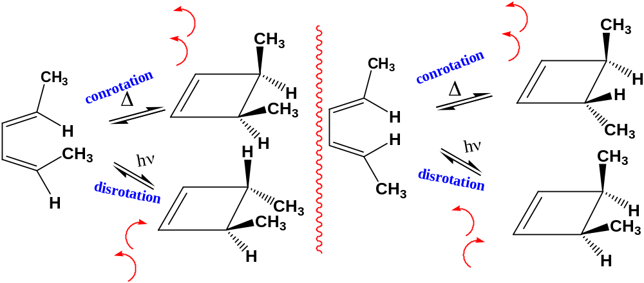
Elcetrocyclic reactions

Slide 10
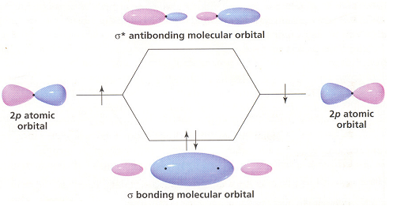
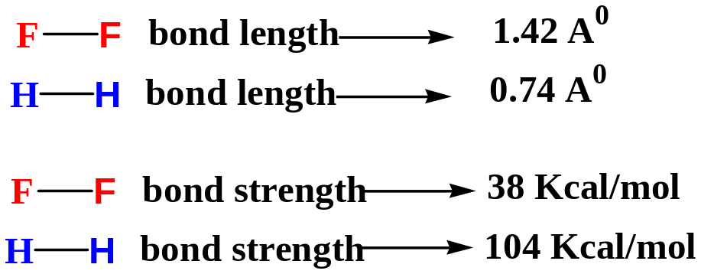

Slide 11
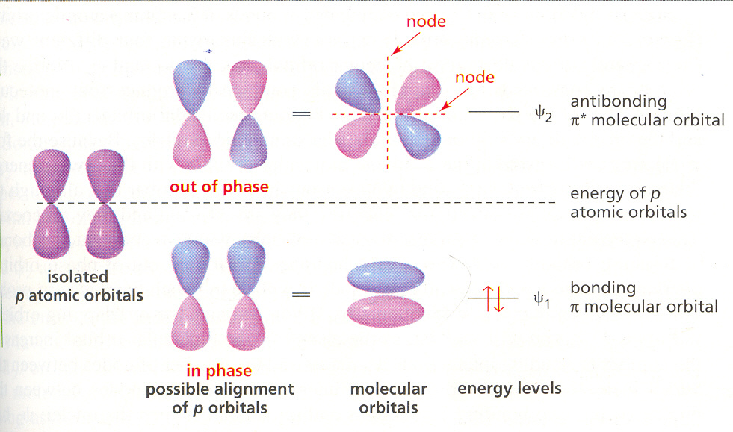
Overlap of in-phase p orbitals gives a bonding π molecular orbital that is lower in energy
than the p atomic orbitals. Overlap of out-of-phase p atomic orbitals gives an antibonding
π molecular orbital that is higher in energy than the p atomic orbitals.

Slide 12
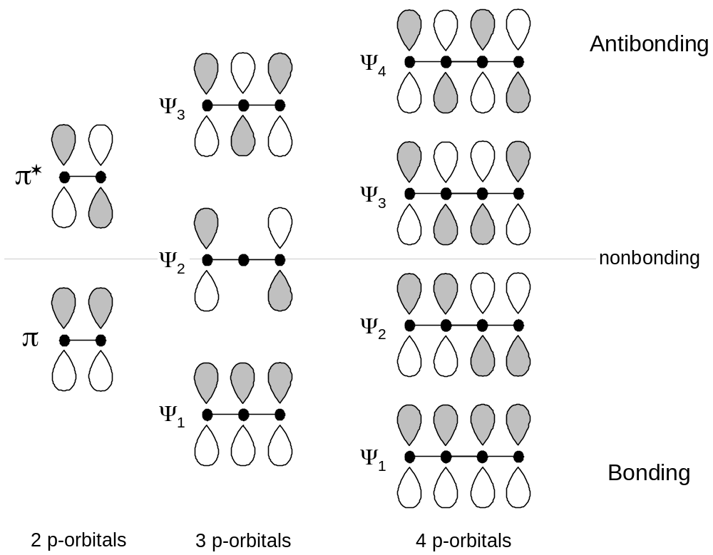
Conjugated π Systems

Slide 13
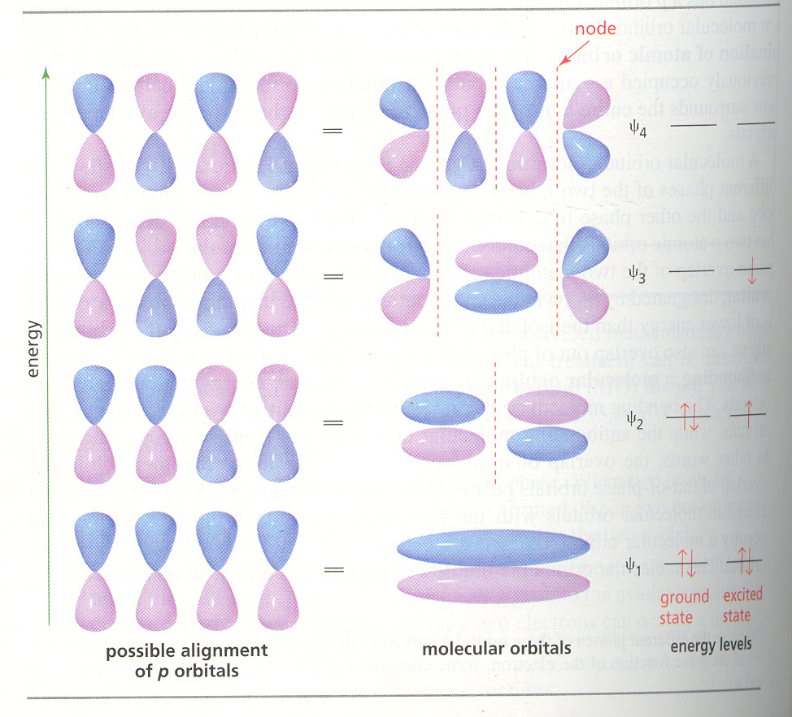
Four p atomic orbitals overlap to give the four π molecular orbitals
of 1,3-butadiene

Slide 14
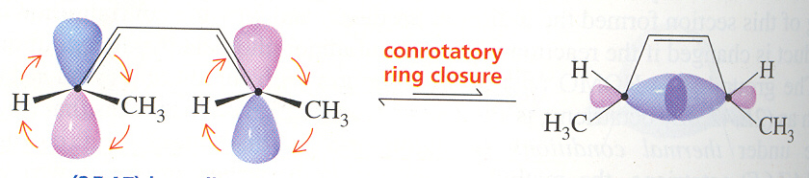
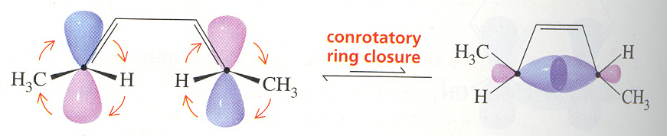
HOMO
HOMO

Slide 15
Selection rules for electrocyclic reactions
No. pi-electrons | Thermally allowed, photochemically forbidden | Thermally forbidden, photochemically allowed
4q | Conrotatory | Disrotatory
4q+2 | Disrotatory | Conrotatory
q = integer

Slide 16
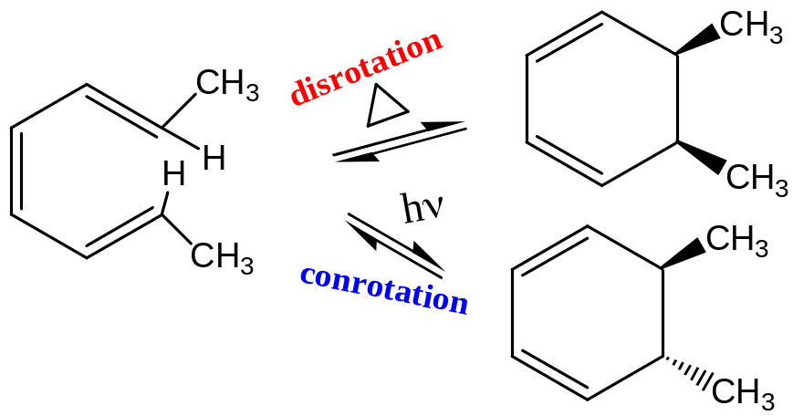
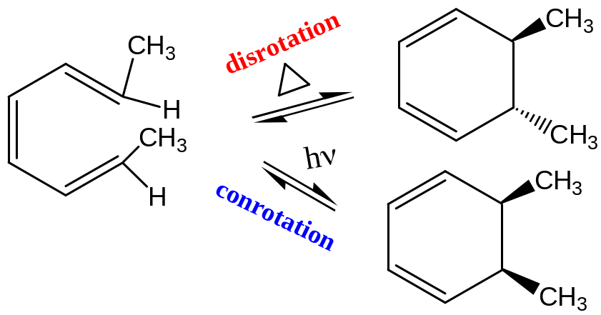

Slide 17
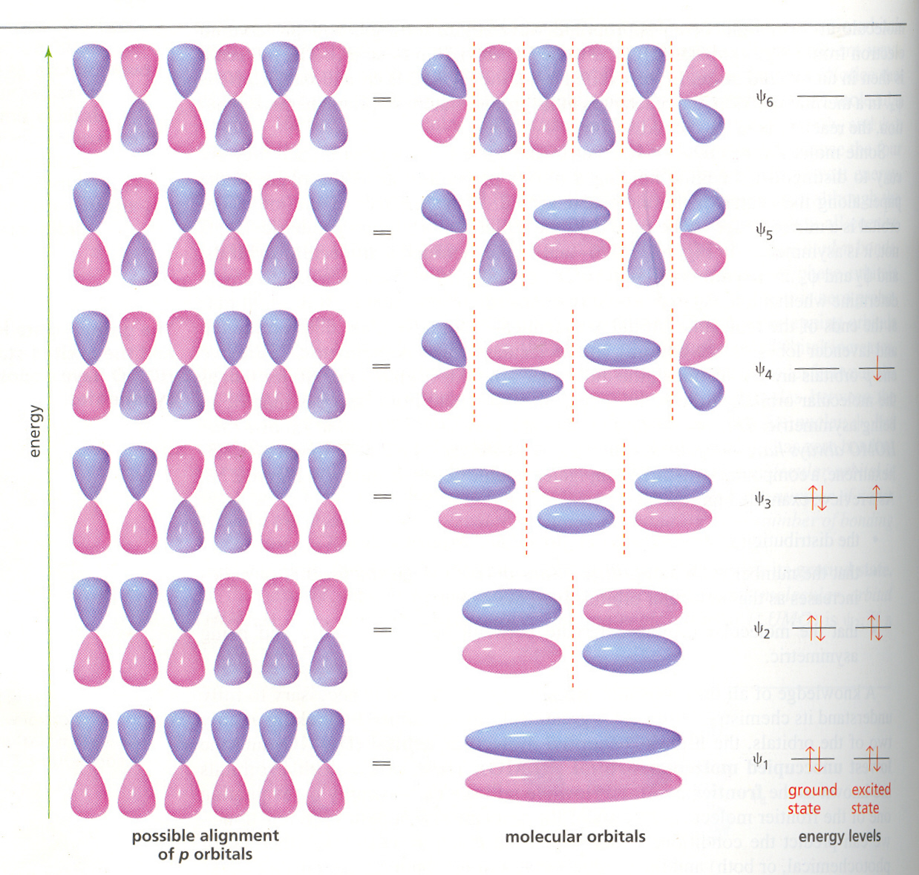
Six p atomic orbitals overlap to give the six π molecular orbitals
of 1,3,5-hexatriene

Slide 18
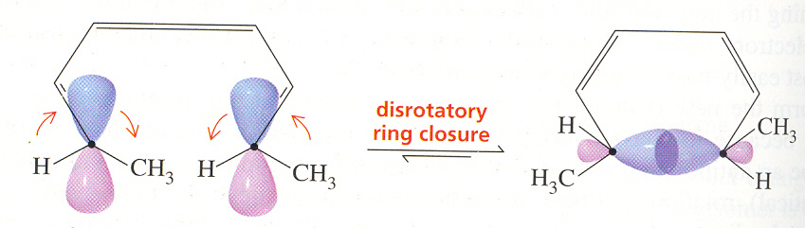
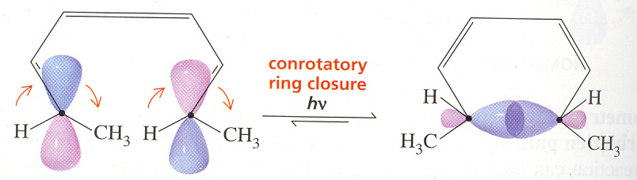
HOMO
LUMO

Slide 19
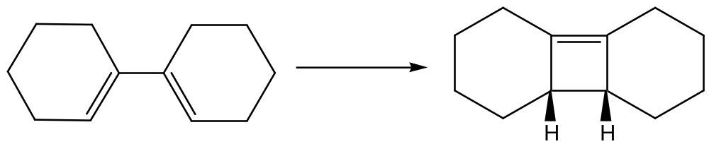
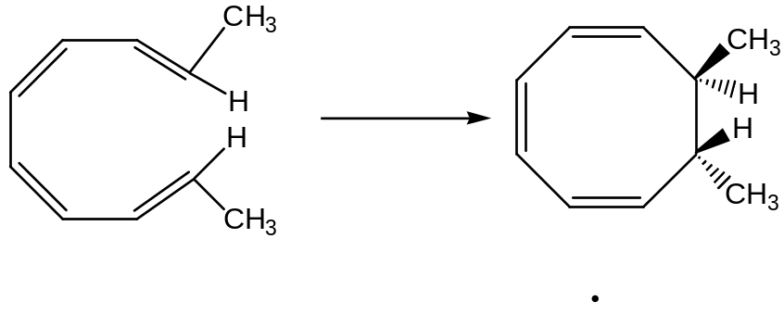
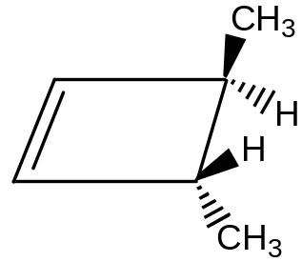
Q. Have the following reactions proceeded in the conrotatory or disrotatory
manner? Should they proceed under thermal or photochemical influence?
*
*
Q. Show that the cyclobutane below open by two alternative conrotarory procsses.
What is the product in each instance? Do you expect them to be formed in equal
amounts?

Slide 20
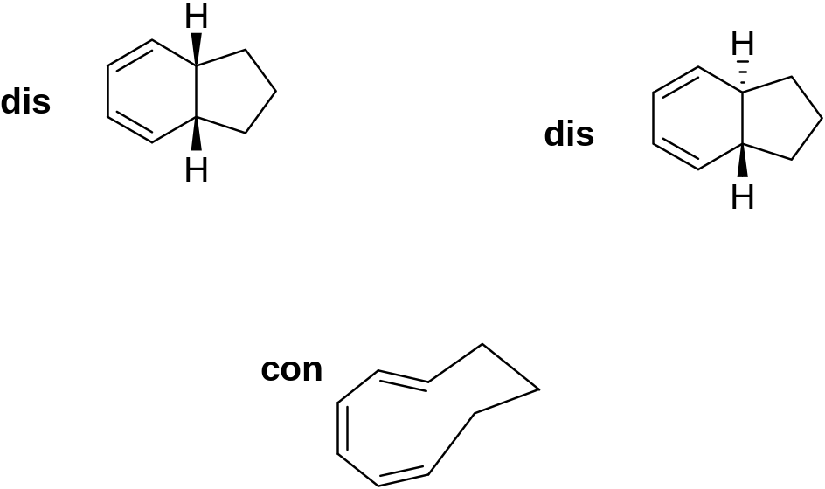
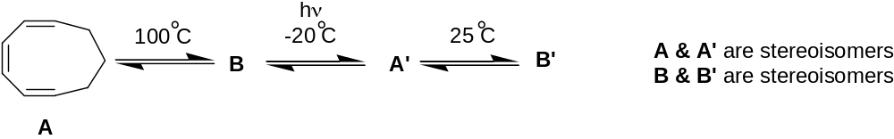

Slide 21
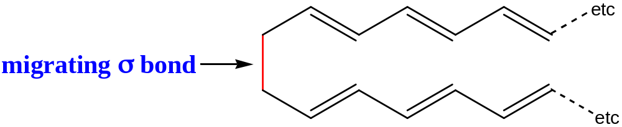
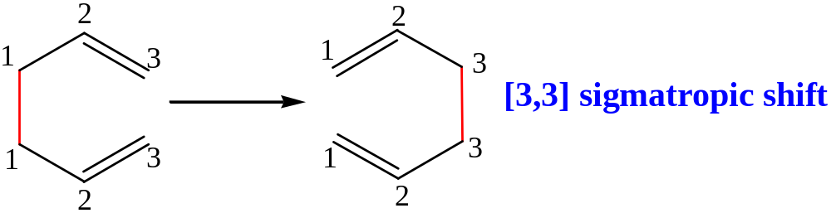
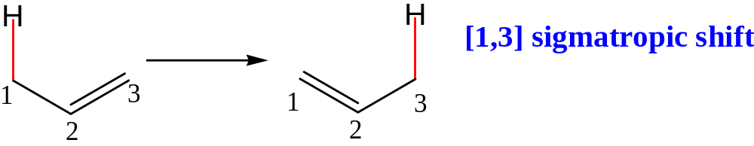
Sigmatropic reactions
These reactions are defined as involving migration of a σ bond that is flanked by
one or more conjugated systems to a new position within the system
The reaction is termed [ i, j ] sigmatropic shift when the bond migrates from
position [1,1] to position [i,j].
Examples:

Slide 22
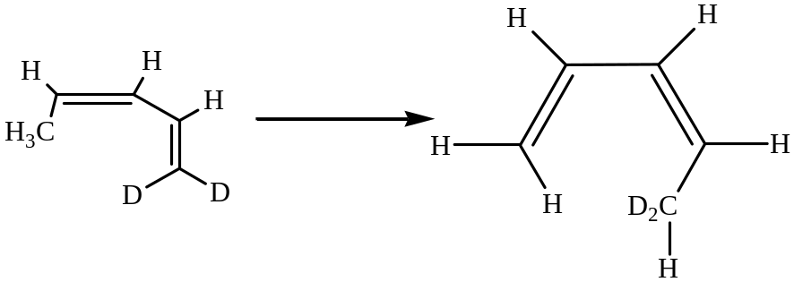
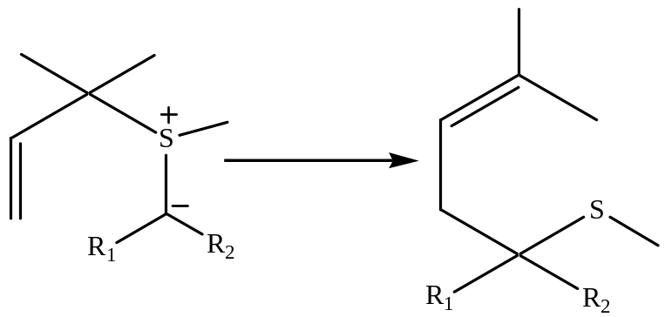
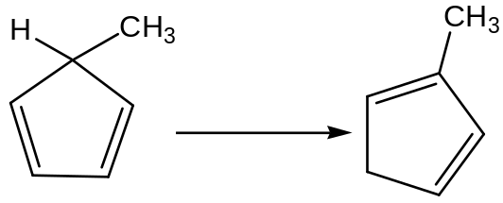
Q. Classify the following sigmatropic reactions of order [i,j]
*
[1,5]
[2,3]
*
[1,5]
*

Slide 23
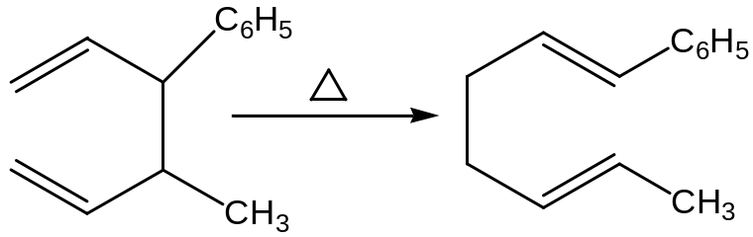
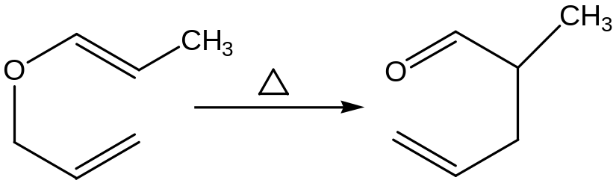
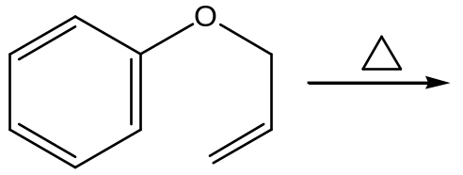
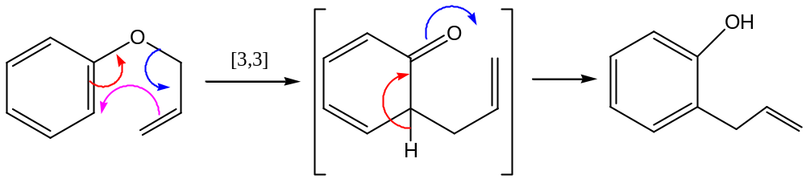
A Cope rearrangement
A Claisen rearrangement
Q. Give the product of the following reaction.

Slide 24
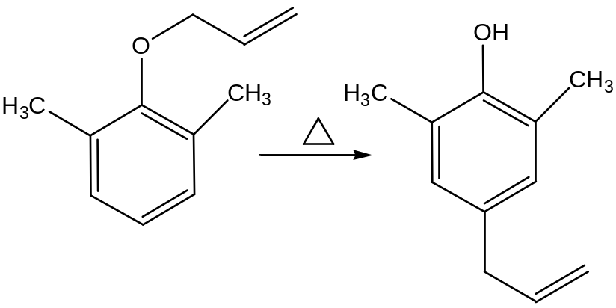
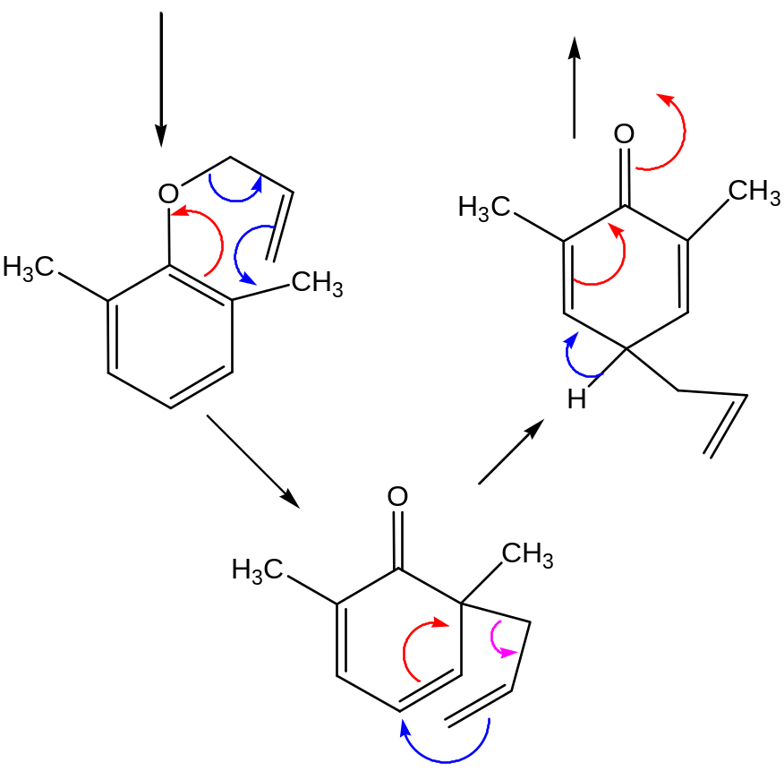
Q. Suggest a mechanism

Slide 25
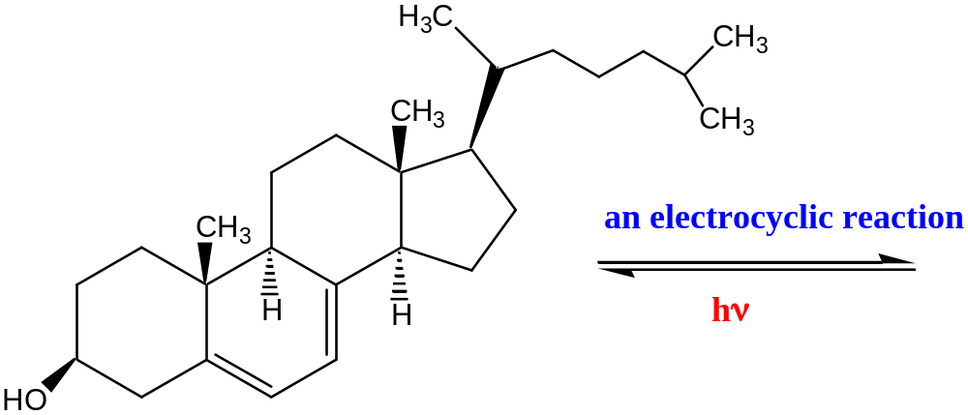
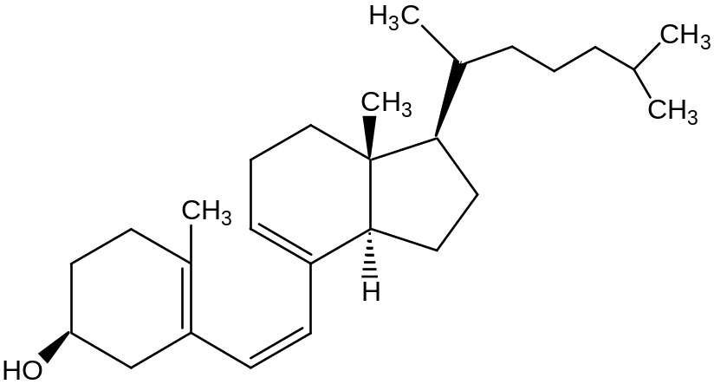
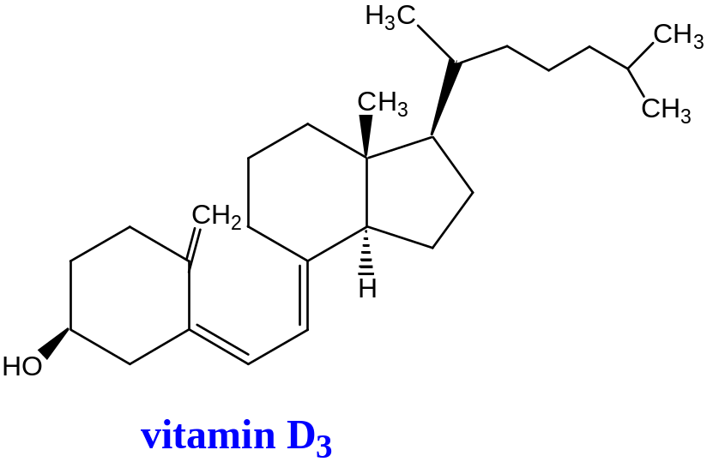

A biological reaction involving an electrocyclic reaction and a sigmatropic reaction
provitamin D₃
7-dehydro cholesterol

Slide 26
7-dehydrocholesterol, a steriod formed in skin, is converted into
Vitamin D₃ by two pericyclic reactions
Deficiency in vitamin D causes rickets.
Deficiency in vitamin D can be prevented by getting
enough sun.
Too much vitamin D is harmful- skin pigmentation
protects the skin from the sun’s UV rays.

Slide 27
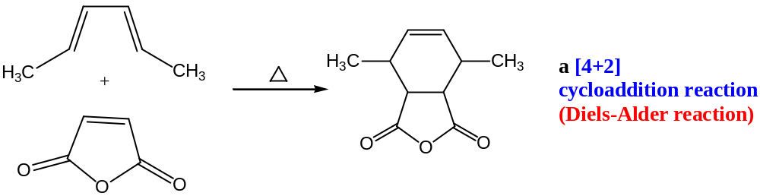
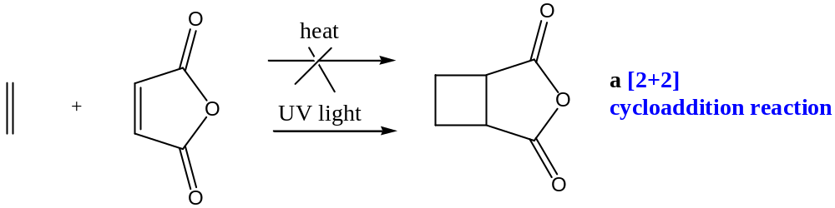
Cycloaddition reactions

Slide 28
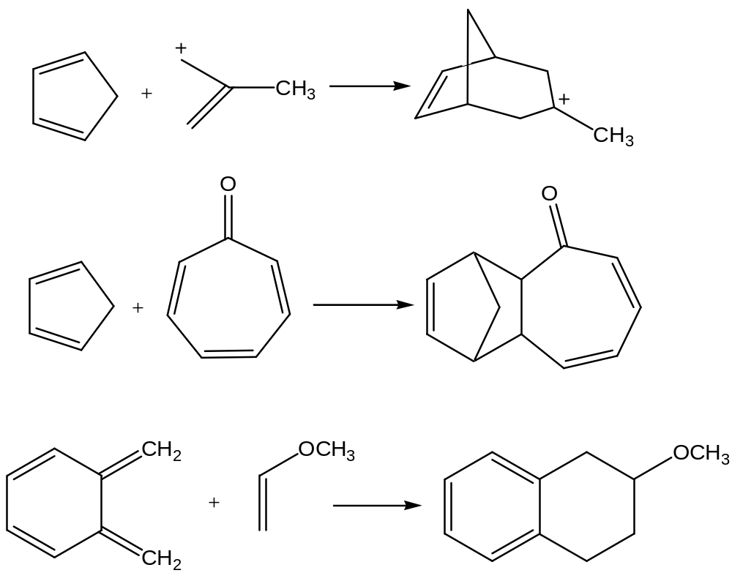
Q. Classify the following as [m+n] cycloaddition reactions
*
*
*

Slide 29



General description of Diels-Alder reaction
Dienes permanently in s-cis conformation (Diels-Alder reactions are excellent)
Dienes permanently in s-trans conformation (cannot undergo Diels-Alder reaction)

Slide 30

Captan
(an industrial application of Diels-Alder reaction)

Slide 31




The endo rule for Diels-Alder reaction

Slide 32

Why pericyclic?
Because all first-order bonding changes occur on a closed curve.
Conrotatory cyclisation of
butadiene

Slide 33
Q. Suggest a mechanism

Slide 34




Slide 35
A biological reaction involving an electrocyclic reaction and a sigmatropic reaction
provitamin D₃
7-dehydro cholesterol

Slide 36



An industrial synthesis of citral

Slide 37
Q. Classify the following as [m+n] cycloaddition reactions
*
*
*

Slide 38
General description of Diels-Alder reaction
Dienes permanently in s-cis conformation (Diels-Alder reactions are excellent)
Dienes permanently in s-trans conformation (cannot undergo Diels-Alder reaction)

Slide 39


Q. Which of the followings do not respond to the Diels-Alder reaction as a diene?
Q. Arrange the following dienes according to their reactivity towards Diels-Alder reaction

Slide 40

Q. Following compounds are synthesized by Diels-Alder reaction, find out suitable dienes and dienophiles for their synthesis.

Slide 41


Slide 42
The endo rule for Diels-Alder reaction

Slide 43

Cycloaddition reactions
Why does maleic anhydride react easily with butadiene,
but not at all easily with ethylene?

Slide 44


LUMO of ethylene (π*)
antibonding interaction
Thermal reaction
forbidden
HOMO of ethylene (π)
_____________________________________________
LUMO
Photochemical reaction is
thus feasible
HOMO (*)

Slide 45

Diels-Alder reaction : endo rule
endo
relationship
between two alkenes
Primary bonding
interactions leading
to new σ bonds
Secondary bonding
Interactions leading
to endo product

Slide 46

Reaction of cyclopentadiene with maleic anhydride

